Slide 1
Introduction to SQL
SQL (pronounced “sequel”) is an acronym for Structured Query Language.
SQL publish by Dr. E. F. Codd at. IBM in 1970
The SQL language (originally called “System R” in the prototype and later called “SEQUEL”) was developed by the IBM Research Laboratory as a standard language to use with relational databases
SQL obey ANSI ( American National Standards Institute) guidelines.

Slide 2
Why Learn SQL
SQL is used by most commercial database applications.
Although the language has evolved over the years with a large array of syntax enhancements and additions, most of the basic functionality has remained essentially unchanged.
SQL knowledge will continue to be a fundamental skill because there is currently no mature and viable alternative language that accomplishes the same functionality.
Learning Oracle’s specific SQL implementation allows you great insight into the feature-rich functionality of one of the largest and most successful database vendors.

Slide 3
What is a database
A database is an organized collection of data.
A database management system (DBMS) is software that allows the creation, retrieval, and manipulation of data.
A relational database management system (RDBMS) provides this functionality within the context of the relational database theory and the rules defined for relational databases by Codd. These rules, called “Codd’s Twelve Rules,”
Compliance with Codd’s Rules has been a major challenge for database vendors, and early versions of relational databases complied with only a handful of the rules.

Slide 4
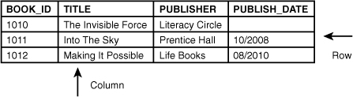
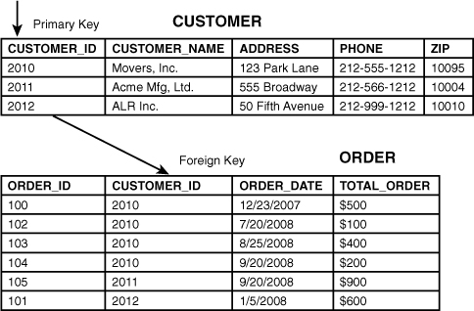
RDBMS Terminology

Slide 5
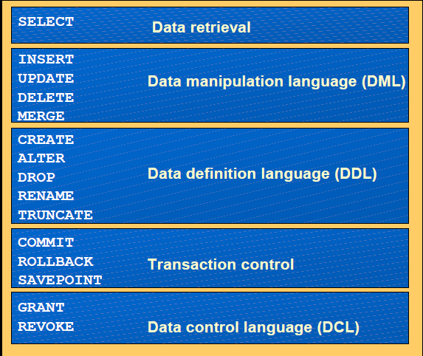
Overview of SQL Language Commands

Slide 6
Data Normalization
The objective of normalization is to eliminate redundancy in tables, therefore avoiding any future data manipulation problems.
When a table is normalized, the non-key columns depend on the key used.
From a relational model point of view, it is standard to have tables that are in Third Normal Form. Normalized physical design provides the greatest ease of maintenance, and databases in this form are clearly understood by developers. However, a fully normalized design may not always yield the best performance.
RDBMS recommends that you design databases till Third Normal Form, however, if performance degrade, you may have to denormalize to solve them
While fully normalized databases require more joins, Joins are generally very fast if indexes are available on the join columns.

Slide 7
First Normal Form
There are three normal form in general for RDBMS.
First Normal form
Second Normal Form
Third Normal Form
First Normal Form : Rule of First Normal Form
Every column must be atomic. It cannot be decompose into two or more sub-columns.
You cannot have multivalue columns or repeating group.
Each row and column position can have only one value.

Slide 8
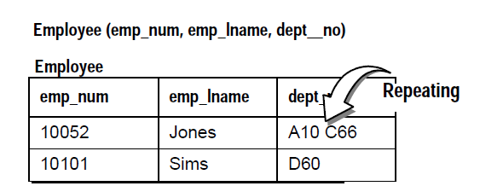
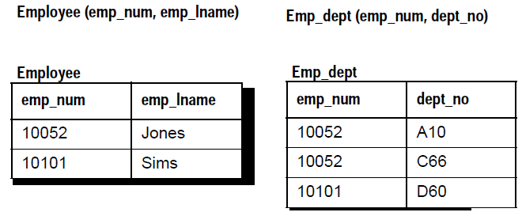
Example 1 : First Normal Form
Adjacent table violates First Normal Form
Correcting First Normal Form violations by creating two tables

Slide 9
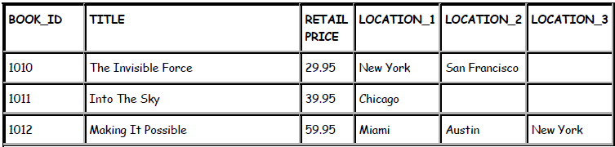
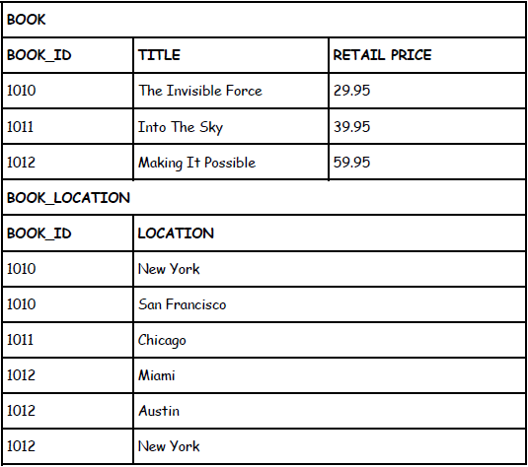
Example 2: First Normal Form

Slide 10
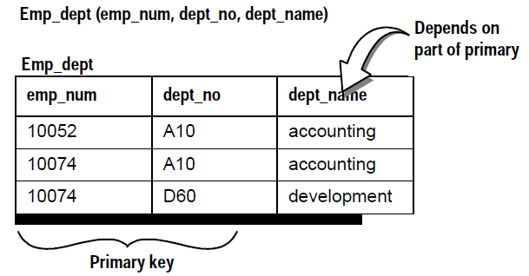
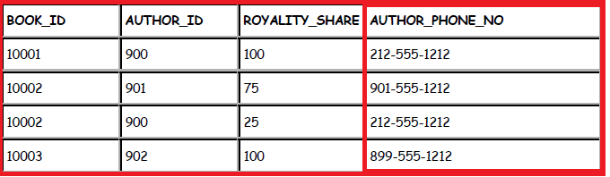
Second Normal Form
Second normal form : For a table to be in Second Normal Form, every non-key field must depend on the entire primary key, not on part of a composite primary key.
If a database has only single-field primary keys, it is automatically in Second Normal Form.

Slide 11
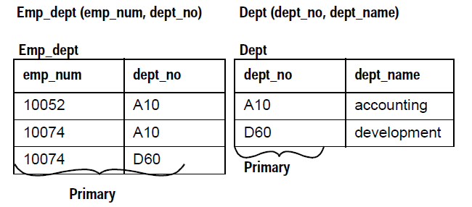
Example of Second Normal Form
Correcting Second Normal Form violations by creating two tables

Slide 12
Example 2: Second Normal Form
Correcting First Normal Form violations by creating two tables

Slide 13
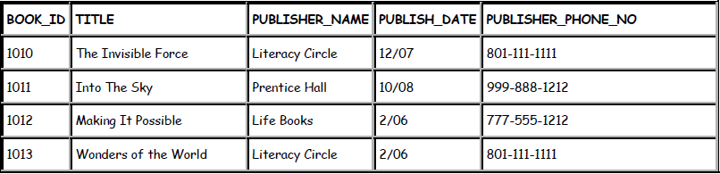
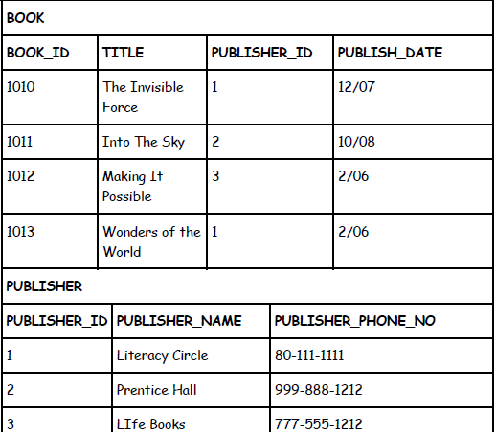
Third Normal Form : Example 1
Third normal form : It goes a step further than the second normal form: It states that every nonkey column must be a fact about the primary key.

Slide 14
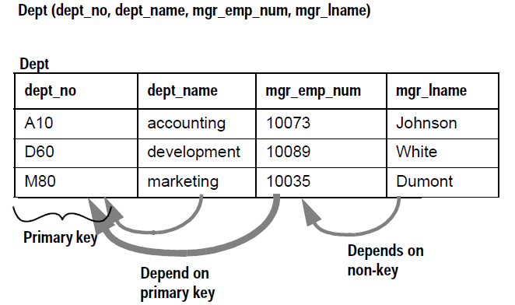
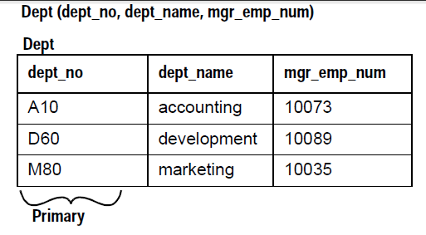
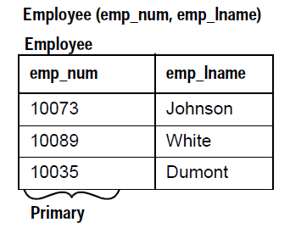
Third Normal Form : Example 2
Third normal form For a table to be in Third Normal Form, a non-key field cannot depend on another non-key field..
Correcting Third Normal Form violations by creating two tables

Slide 15
Denormalization
Once you have normalized your database, you can run benchmark tests to verify performance. You may have to denormalize for specific queries and/or applications.
Denormalizing:
Can be done with tables or columns
Assumes prior normalization
Requires a thorough knowledge of how the data is being used
You may want to denormalize if:
All or nearly all of the most frequent queries require access to the full set of joined data.
A majority of applications perform table scans when joining tables.
Computational complexity of derived columns requires temporary tables or excessively complex queries.

Slide 16
Advantage and Disadvantage of Denormalization
Disadvantages
Denormalization has these disadvantages:
• It usually speeds retrieval but can slow data modification.
• It is always application-specific and must be re-evaluated if the application changes.
• It can increase the size of tables.
• In some instances, it simplifies coding; in others, it makes coding more complex.
Performance advantages
Denormalization can improve performance by:
Minimizing the need for joins
Reducing the number of foreign keys on tables
Reducing the number of indexes, saving storage space, and reducing data modification time
Pre-computing aggregate values, that is, computing them at data modification time rather than at select time
Reducing the number of tables (in some cases)

Slide 17
Table relationship
When two tables have a common column or columns, the tables are said to have a relationship between them
Three type of relationship
1. One-to-Many (1:M)
2. One-to-One ( 1:1)
3. Many-to-Many (M:M)

Slide 18
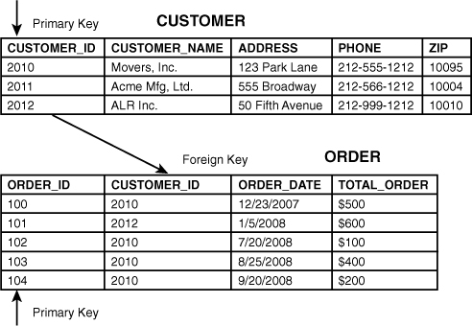
One-To-Many Relationship

Slide 19
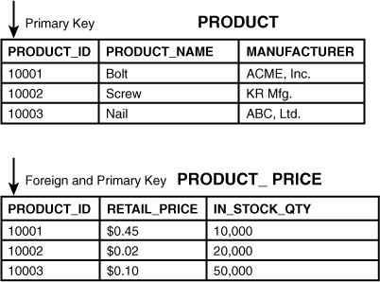
One-To-One Relationship

Slide 20
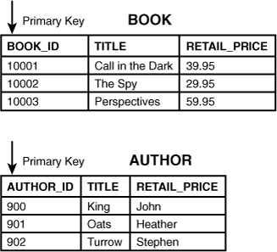
Many-to-Many Relationship
One book can have one or more authors, and one author can write one or more books. The relational database model requires the resolution of many-to-many relationships into one-to-many relationship tables.
The solution in this example is achieved by creating an associative table (also called an intersection table) via the BOOK_AUTHOR table.

Slide 21
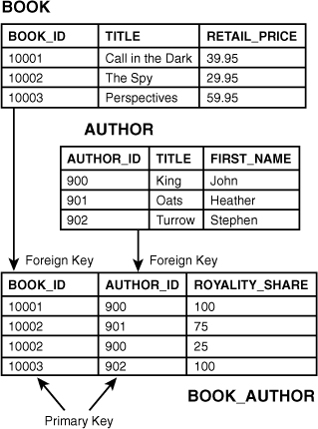
Many-to-Many continue..

Slide 22
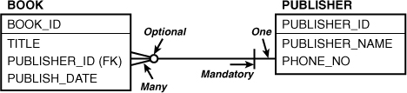
Database Schema Diagrams
For clarity of meaning and conceptual consistency, it is useful to show table relationships using database schema diagrams. There are a number of standard notations for this type of diagram.
Cardinality : The cardinality expresses the ratio of a parent and child table from the perspective of the parent table. It describes how many rows you may find between the two tables
for a given primary key value.
Optionality : Graphical relationship lines also indicate the optionality of a relationship, whether a row is required or not (mandatory or optional). Specifically, optionality shows whetherone row in a table can exist without a row in the related table.

Slide 23
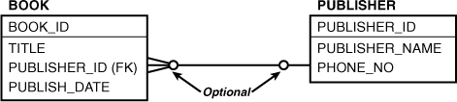
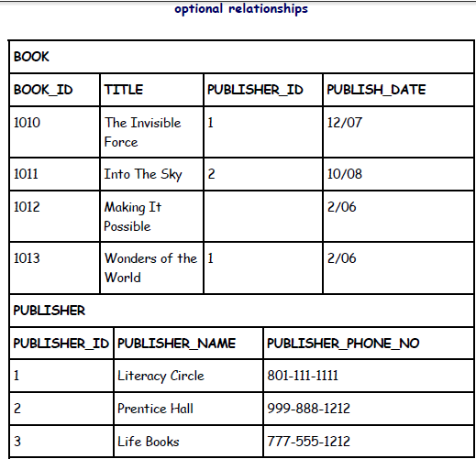
Optional relationship notation on both sides
First depicted diagram shows an optional relationship on both sides; a book may be published by zero or one publisher. Effectively, this means the value in the PUBLISHER_ID column in BOOK is optional. Reading the relationship from PUBLISHER, you can say that “one publisher may publish zero, one, or many books”

Slide 24
Real-World Business Practice
You typically see only two types of relationships:
First: mandatory on the “one” side and optional on the “many” end;
Second : optional on both ends.
Only rarely do you find other types of relationships. For example, mandatory relationships on both sides are infrequently implemented; this means that rows must be inserted in both tables simultaneously.
Occasionally, you find one-to-one relationships, but most often, the columns from both tables are combined into one table.
Many-to-many relationships are not allowed in the relational database; they must be resolved via an associative, or intersection, table into one-to-many relationships.

Slide 25
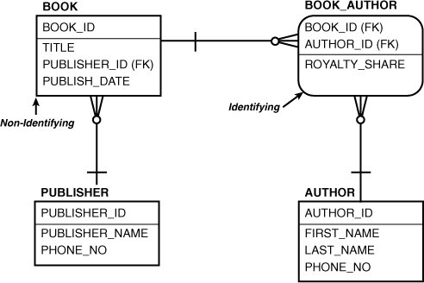
Identifying and Nonidentifying Relationships
In an identifying relationship, the primary key is propagated to the child entity as part of the primary key. This is in contrast to a nonidentifying relationship, in which the foreign key becomes one of the nonkey columns. A nonidentifying relationship may accept a null value in the foreign key column.

Slide 26
Oracle DDL Command
The Oracle CREATE TABLE statement allows you to create and define a table.
Create Table - By Copying all columns from another table
Create Table – By Copying some column from another table
Create table - By Copying selected columns from multiple tables
Global Temporary Table
Local Temporary Table
Example : -
CREATE TABLE suppliers
(
supplier_id number(10) NOT NULL,
supplier_name varchar2(50) NOT NULL,
suppl_date date ,
address varchar2(50),
city varchar2(50),
state varchar2(25),
zip_code varchar2(10)
);

Slide 27
Create table with constraints
CREATE TABLE employees
( employee_number number(10) NOT NULL,
employee_name varchar2(50) NOT NULL,
department_id number(10),
salary number(6),
CONSTRAINT employees_pk PRIMARY KEY (employee_number),
CONSTRAINT fk_departments
FOREIGN KEY (department_id)
REFERENCES departments(department_id)
);
> We can give constraints name, next to column name.

Slide 28
Create Table - By Copying all/Some columns from another table
By copying all columns
CREATE TABLE suppliers AS
(SELECT * FROM companies WHERE company_id < 5000);
By copying all columns
CREATE TABLE suppliers
AS (SELECT company_id, address, city, state, zip
FROM companies
WHERE company_id < 5000);
Note :
Table created by all/some columns from another table, does not copy constraints.
All the columns constraints resides in USER_CONSTRAINTS dictionary tables.

Slide 29
ALTER TABLE Statement
The Oracle ALTER TABLE statement is used to add, modify, or drop columns in a table. The Oracle ALTER TABLE statement is also used to rename a table.
Add column in table
Add multiple columns in table
Modify column in table
Modify Multiple columns in table
Drop column in table
Rename column in table
Rename table

Slide 30
DROP TABLE Statement
DROP [schema_name].TABLE table_name
[ CASCADE CONSTRAINTS ]
[ PURGE ];
DROP TABLE customers PURGE;
CASCADE CONSTRAINTS Optional. If specified, all referential integrity constraints will be dropped as well.
PURGE Optional. If specified, the table and its dependent objects will be purged from the recycle bin and you will not be able to recover the table. If not specified, the table and its dependent objects are placed in the recycle bin and can be recovered later, if needed.
Note: If there are referential integrity constraints on table_name and you do not specify the CASCADE CONSTRAINTS option, the DROP TABLE statement will return an error and Oracle will not drop the table.

Slide 31
Database constraints
There 8 constraints in Oracle Database
Primary Keys
Using CREATE TABLE statement
Using ALTER TABLE statement
Foreign Keys
Using CREATE TABLE statement
Using ALTER TABLE statement
Unique Constraints
Check Constraints
NOT NULL

Slide 32
Primary key
In Oracle, a primary key is a single field or combination of fields that uniquely defines a record. None of the fields that are part of the primary key can contain a null value. A table can have only one primary key.
NOT NULL + UNIQUE KEY
In Oracle, a primary key can not contain more than 32 columns.
A primary key can be defined in either a CREATE TABLE statement or an ALTER TABLE statement.

Slide 33
Foreign Keys
A foreign key is a way to enforce referential integrity within your Oracle database. A foreign key means that values in one table must also appear in another table.
The referenced table is called the parent table while the table with the foreign key is called the child table. The foreign key in the child table will generally reference a primary key in the parent table.
ON CASCADE DELETE : A foreign key with cascade delete means that if a record in the parent table is deleted, then the corresponding records in the child table will automatically be deleted. This is called a cascade delete in Oracle.
DELETE SET NULL : A foreign key with "set null on delete" means that if a record in the parent table is deleted, then the corresponding records in the child table will have the foreign key fields set to null. The records in the child table will not be deleted.

Slide 34
Unique constraint
A unique constraint is a single field or combination of fields that uniquely defines a record. Some of the fields can contain null values as long as the combination of values is unique.
In Oracle, a unique constraint can not contain more than 32 columns.
Some of the fields that are part of the unique constraint can contain null values as long as the combination of values is unique.

Slide 35
Check Constraints
A check constraint allows you to specify a condition on each row in a table
A check constraint can NOT be defined on a SQL View.
The check constraint defined on a table must refer to only columns in that table. It can not refer to columns in other tables.
A check constraint can NOT include a SQL Subquery.
A check constraint can be defined in either a SQL CREATE TABLE statement or a SQL ALTER TABLE statement.

Slide 36
DML - Insert
The Oracle INSERT statement is used to insert a single record or multiple records into a table in Oracle.
Using VALUES keyword
Using SELECT statement – With Column
INSERT ALL
INSERT INTO TABLE -- Without columns
How to insert partial column(Null)

Slide 37
DML - Update
The Oracle UPDATE statement is used to update existing records in a table in an Oracle database
UPDATE statement when updating one table
UPDATE table
SET column1 = expression1,
column2 = expression2, ...
column_n = expression_n,
WHERE conditions;
Oracle UPDATE statement when updating one table with data from another table
UPDATE table1
SET column1 = (SELECT expression1 FROM table2 WHERE conditions)
WHERE conditions;

Slide 38
DML – DELETE/TRUNCATE
The Oracle DELETE statement is used to delete a single record or multiple records from a table
DELETE FROM table WHERE conditions;
Using EXISTS Clause
DELETE FROM suppliers
WHERE EXISTS ( SELECT customers.customer_name FROM customers WHERE customers.customer_id = suppliers.supplier_id AND customer_id > 25 );
TRUNCATE : The TRUNCATE TABLE statement is used to remove all records from a table in Oracle
Syntax :
TRUNCATE TABLE [schema_name.]table_name
[ PRESERVE MATERIALIZED VIEW LOG | PURGE MATERIALIZED VIEW LOG ]
[ DROP STORAGE | REUSE STORAGE ] ;

Slide 39
Difference b/n Delete and Truncate
DELETE | TRUNCATE
DELETE TABLE TableName | TUNCATE TABLE TableName
Rollback Possible | Rollback Not possible
Slow way of deleting the data | Fast way of deleting the data
It affects Index, trigger and dependencies | Doesn’t affect index, trigger and dependency
Doesn’t Reset HWM | Reset HWM
We can use Where clause | Can’t use where clause
Note : If you want conditional truncate then you can partition the table and do truncate for specific partition. Moreover You cannot roll back a TRUNCATE TABLE statement, nor can you use a FLASHBACK TABLE statement to retrieve the contents of a table that has been truncated.

Slide 40
SQL Data Type
In SQL there are following family group of data type
Character Data type
Numeric Data types
Date/Time Data types
Large Object (LOB) Data types
Rowid Data types

Slide 41
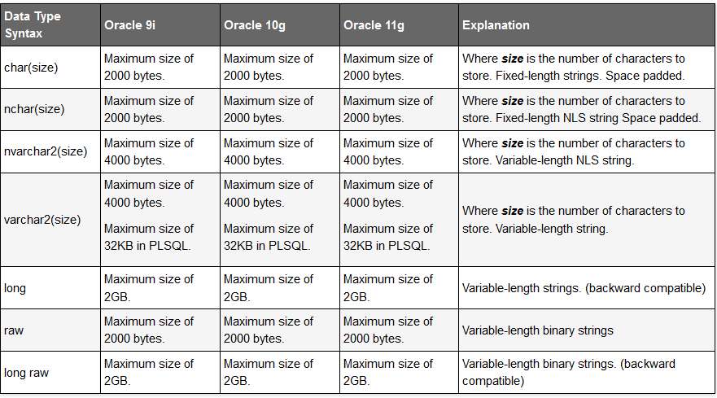
Character Data types
select * from nls_database_parameters where parameter like '%CHARACTERSET';

Slide 42
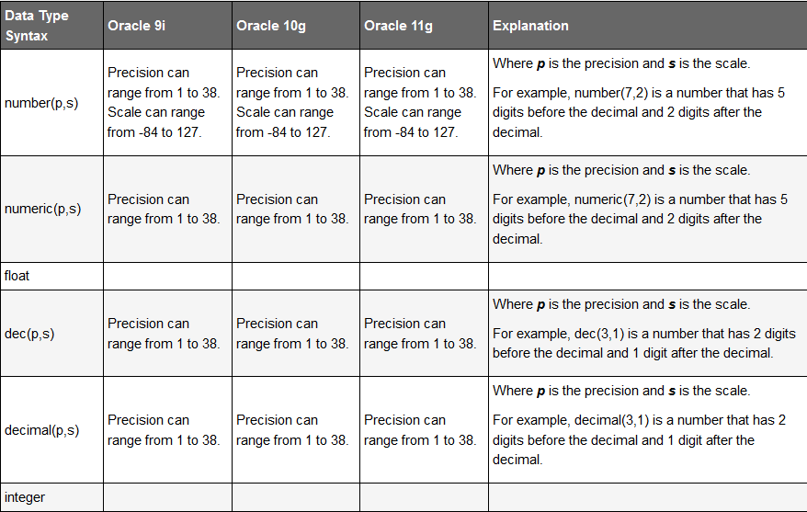
Number Data type

Slide 43
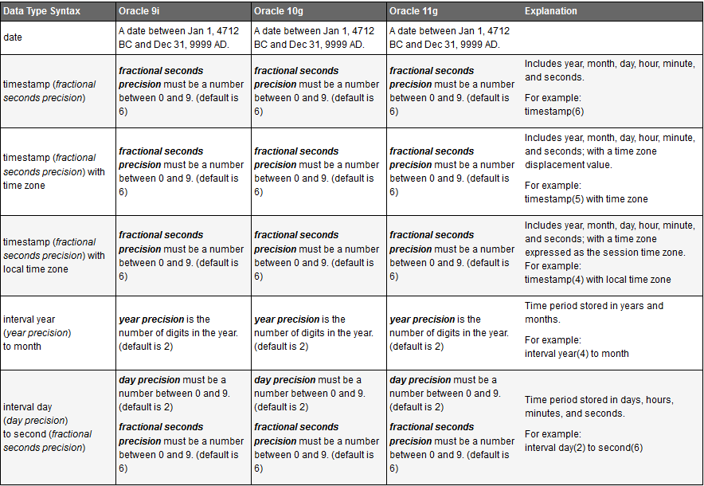
Date data type

Slide 44
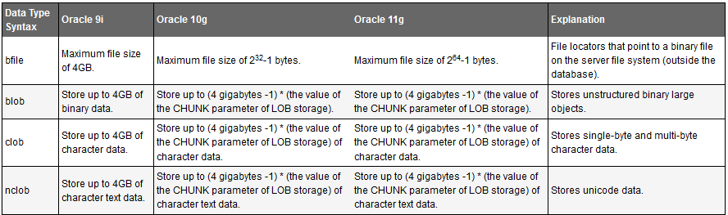
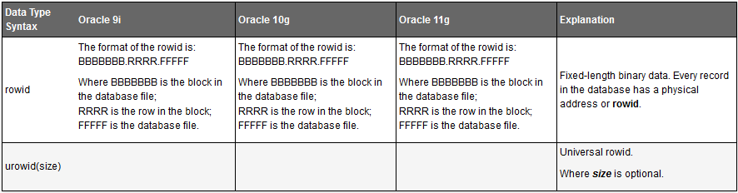
Large Object (LOB)/ Rowid Data types

Slide 45
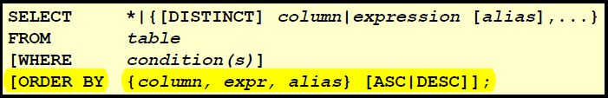
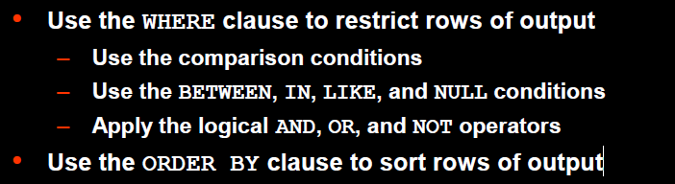
Select Statement

Slide 46
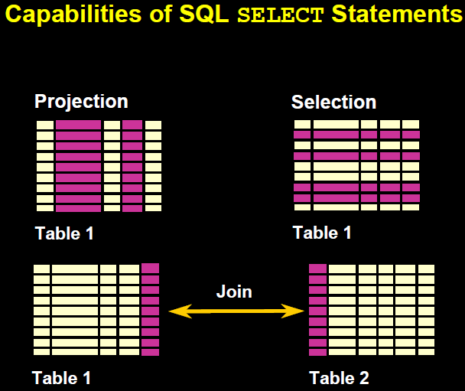

Slide 47
WHERE clause with comparison operators
To filter a data set, you need to specify a WHERE clause condition, which results in true, false, or unknown.
The condition consists of an expression that can be a column of any data type, a string or text literal (sometimes referred to as a text constant or character literal), a number, a function, a mathematical computation, or any combination of these.
The comparison operators evaluate the expressions for the selection of the appropriate data.
Character strings and date values are enclosed in single quotation marks.
Character values are case sensitive, and date values are format sensitive.
The default date format is DD-MON-RR.

Slide 48
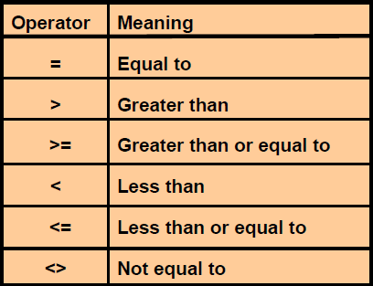
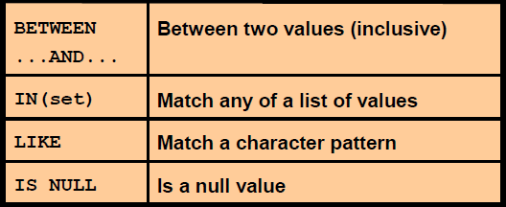
WHERE clause with comparison operators continue..

Slide 49
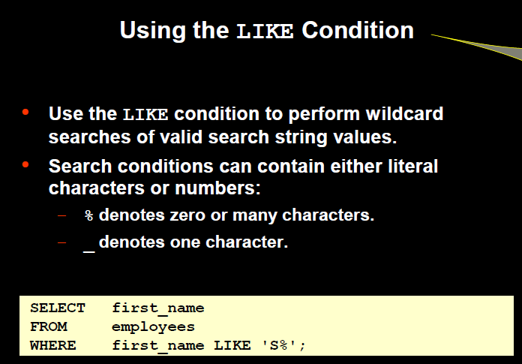
Like condition

Slide 50
What is NULL in Oracle
A null is a value that is unavailable, unassigned, unknown, or inapplicable.
A null is not the same as zero or a blank space.
Arithmetic expressions containing a null value evaluate to null.
Null is never equal to Null it evaluate NULL.
NULL <> ‘NULL’
The IS NULL and IS NOT NULL operators evaluate whether a data value is NULL or not, However oracle internally compare “NULL = NULL”.
SQL uses tri-value logic; this means a condition can evaluate to true, false, or unknown
By default NULL comes last in Order by clause. To make null first use (ORDER BY cost NULLS FIRST)

Slide 51
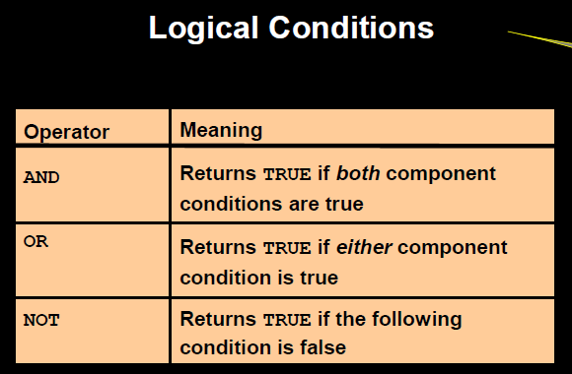

Slide 52
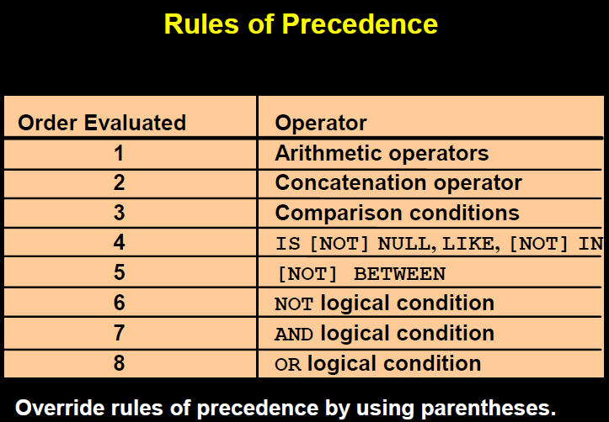

Slide 53
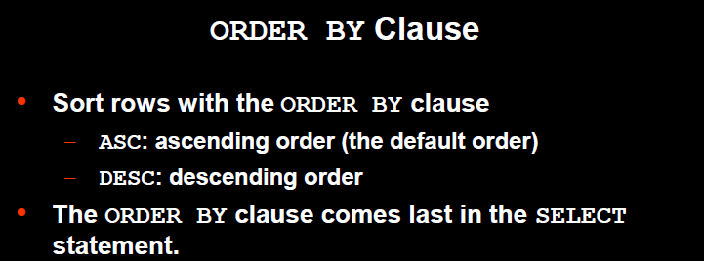


Slide 54
Distinct and Unique
The Oracle DISTINCT clause is used to remove duplicates from the result set. The DISTINCT clause can only be used with SELECT statements.
SELECT DISTINCT/Unique expressions FROM tables;
When only one expression is provided in the DISTINCT clause, the query will return the unique values for that expression.
When more than one expression is provided in the DISTINCT clause, the query will retrieve unique combinations for the expressions listed.
In Oracle, the DISTINCT clause doesn't ignore NULL values. So when using the DISTINCT clause in your SQL statement, your result set will include NULL as a distinct value.
We can find distinct value by GROUP BY Clause, when only SINGLE COLUMN available in select list.

Slide 55
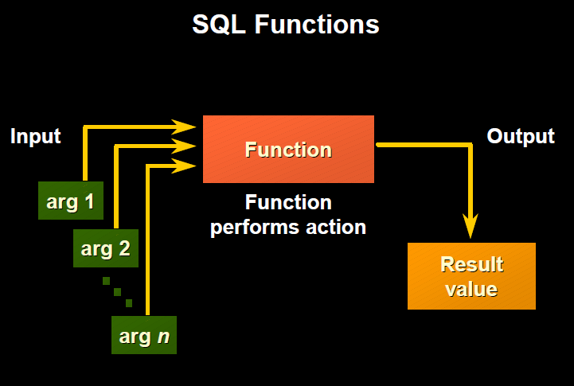
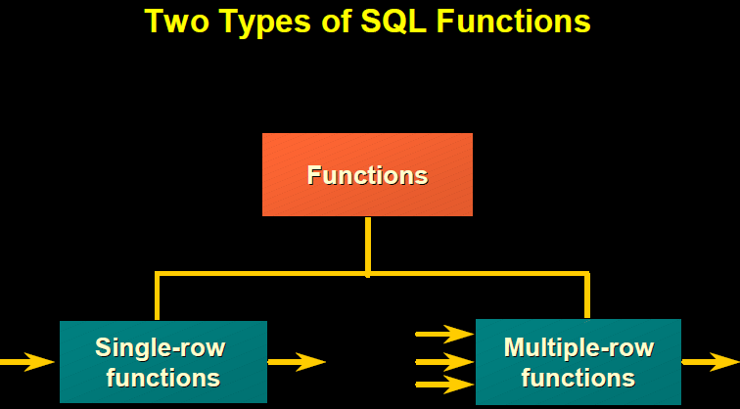

Slide 56
Single-Row Functions
Single row functions:
Manipulate data items
Accept arguments and return one value
Act on each row returned
Return one result per row
May modify the data type
Can be nested
Accept arguments which can be a column or an Expression

Slide 57
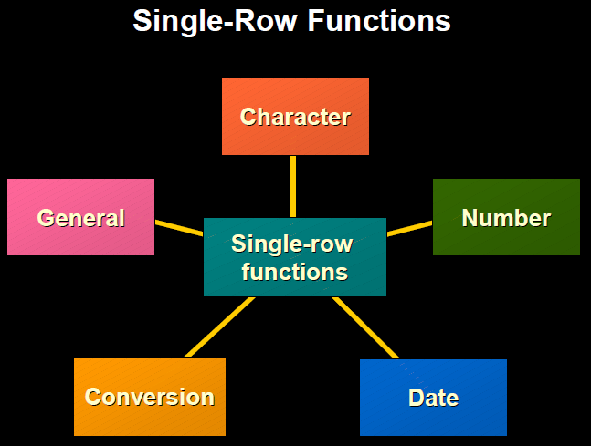
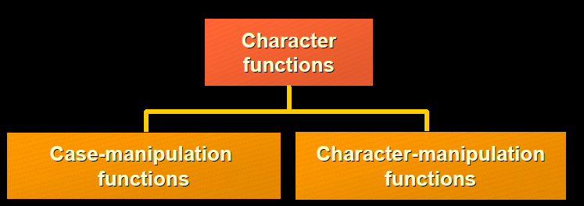

Slide 58
Number Function
ABS( number )
CEIL( number )
FLOOR( number )
ROUND( number [, decimal_places] )
TRUNC( number [, decimal_places] )
SIGN( number )
MOD( m, n ) -- cal: m - n * floor(m/n)
REMAINDER(m,n) --cal; m- n * round(m/n)

Slide 59
Case-Manipulation
LOWER(char)
UPPER(char)
INITCAP(char)
Character-Manipulation
ASCII(x)
CHR(x)
LPAD(char1, n [, char2])
RPAD(char1, n [, char2])
LTRIM(char1 [, char2])
RTRIM(char1 [, char2])
TRIM([LEADING|TRAILING|BOTH] char1 FROM char2)
SUBSTR(char1, starting_position[,substring_length])
INSTR(char1, char2 [,starting_position[,occurrence]])
LENGTH(char)
CONCAT(char1, char2) -- Same as ||
REPLACE(char, if, then)
TRANSLATE(char, if, then)

Slide 60
General Functions and CASE Expressions
NVL(input_expression , substitution_expression)
COALESCE(input_expression, substitution_expression_1, [,substitution_expression_n])
NVL2 (input_expr,not_null_substitution_expr, null_substitution_expr)
NULLIF(expression1,equal_expression2)
DECODE (if_expr,equals_search, then_result[,else_default])
CASE
{WHEN cond THEN return_expr
[WHEN cond THEN return_ expr]...}
[ELSE else_expr]
END
CASE {expr
WHEN expr THEN return_expr
[WHEN expr THEN return_expr]...}
[ELSE else_expr]
END

Slide 61
Difference between CASE and DECODE
CASE can work with logical operators other than ‘=’
DECODE works with expressions that are scalar values only. CASE can work with predicates and subqueries in searchable form.
CASE can work as a PL/SQL construct
CASE handles NULL differently
CASE expects datatype consistency, DECODE does not
CASE is ANSI SQL-compliant

Slide 62
Group By Clause

Slide 63
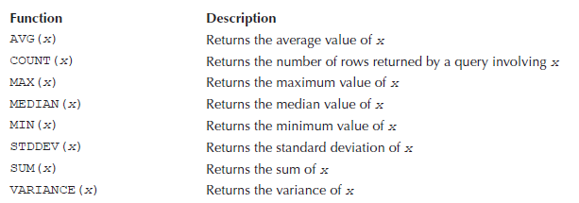
Multi-Row(Aggregate) Functions
COUNT( { * | [DISTINCT|ALL] expression)
SUM([DISTINCT|ALL] value)
AVG( [DISTINCT|ALL] value)

Slide 64
Date Functions
By default the database uses the format DD-MON-YYYY to represent a date.
Using ANSI standard dates in SQL statements has the advantage that those statements could potentially run against non-Oracle databases.(YYYY-MM-DD)
TO_CHAR(x [, format]) : Converts x to a string. You can also supply an optional format for x. You saw how to use TO_CHAR() to convert a number to a string in the previous chapter.
TO_DATE(x [, format]) : Converts the string x to a DATE.
The default date format is specified in the NLS_DATE_FORMAT database parameter.
Date format YY and RR.

Slide 65
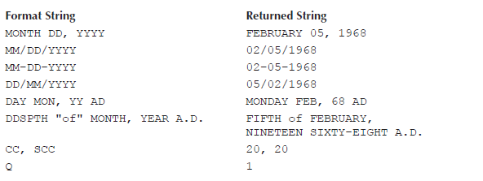
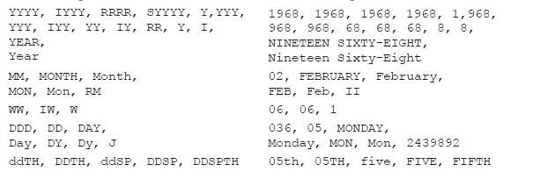
To_CHAR : Format Parameter

Slide 66
YY and RR Format Example
YY Format : If your date format uses YY for the year and you supply only two digits of a year, then the century for your year is assumed to be the same as the present century currently set on the database server. Therefore, the first two digits of your supplied year are set to the first two digits of the present year.
RR Format: If your date format is RR and you supply the last two digits of a year, the first two digits of your year are determined using the two-digit year you supply (your supplied year) and the last two digits of the present date on the database server (the present year). The rules used to determine the century of your supplied year are as follows:

Slide 67
Rule to determine century in RR Format
Rule 1 : If your supplied year is between 00 and 49 and the present year is between 00 and 49, the century is the same as the present century. Therefore, the first two digits of your supplied year are set to the first two digits of the present year. For example, if your supplied year is 15 and the present year is 2007, your supplied year is set to 2015.
Rule 2 : If your supplied year is between 50 and 99 and the present year is between 00 and 49, the century is the present century minus 1. Therefore, the first two digits of your supplied year are set to the present year’s first two digits minus 1. For example, if your supplied year is 75 and the present year is 2007, your supplied year is set to 1975.
Rule 3 : If your supplied year is between 00 and 49 and the present year is between 50 and 99, the century is the present century plus 1. Therefore, the first two digits of your supplied year are set to the present year’s first two digits plus 1. For example, if your supplied year is 15 and the present year is 2075, your supplied year is set to 2115.
Rule 4 : If your supplied year is between 50 and 99 and the present year is between 50 and 99, the century is the same as the present century. Therefore, the first two digits of your supplied year are set to the first two digits of the present year. For example, if your supplied year is 55 and the present year is 2075, your supplied year is set to 2055.

Slide 68
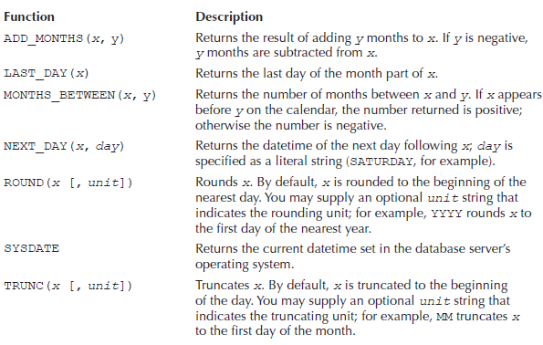
Datetime Functions

Slide 69
Time Zone
Oracle Database 9i introduced the ability to use ifferent time zones. A time zone is an offset from the time in Greenwich, England. The time in Greenwich was once known as Greenwich Mean Time (GMT), but is now known as Coordinated Universal Time (UTC, which comes from the initials of the French wording).
You specify a time zone using either an offset from UTC or a geographic region (e.g., PST, EST).
When you specify an offset, you use HH:MI prefixed with a plus or minus sign: +|-HH:MI
Where + or – indicates an increase or decrease for the offset from UTC.
HH:MI specifies the offset in hours and minutes for the time zone.
Examples :
The following example shows offsets of 8 hours behind UTC and 2 hours 15 minutes ahead of UTC:
-08:00
+02:15
You can obtain all the time zone names by selecting all the rows from v$timezone_names.

Slide 70
Managing Views
About Views : A view is a logical representation of another table or combination of tables.
A view derives its data from the tables on which it is based. These tables are called base tables.
Base tables might in turn be actual tables or might be views themselves.
All operations performed on a view actually affect the base table of the view.
You can use views in almost the same way as tables. You can query, update, insert into, and delete from views, just as you can standard tables
Use of Views :
To restrict data access
To make complex queries easy
To provide data independence
To present different views of the same data

Slide 71
Create view privilege
To create a view, you must meet the following requirements:
To create a view in your schema, you must have the CREATE VIEW privilege.
To create a view in another user's schema, you must have the CREATE ANY VIEW system privilege.
The functionality of the view depends on the privileges of the view owner. For example, if the owner of the view has only the INSERT privilege for Scott's emp table, then the view can be used only to insert new rows into the emp table, not to SELECT, UPDATE, or DELETE rows.
If the owner of the view intends to grant access to the view to other users, the owner must have received the object privileges to the base objects with the GRANT OPTION or the system privileges with the ADMIN OPTION

Slide 72
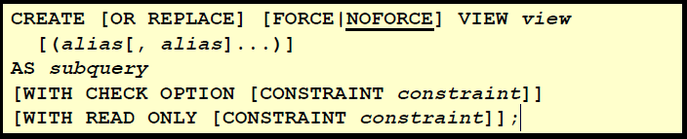
View Syntax
WITH CHECK OPTION : You can ensure that DML operations performed on the view stay within the domain of the view by
using the WITH CHECK OPTION clause.
Any attempt to change the department number for any row in the view fails because it violates the WITH CHECK OPTION constraint.
WITH READ ONLY :
You can ensure that no DML operations occur by adding the WITH READ ONLY option to your view definition.
Any attempt to perform a DML on any row in the view results in an Oracle server error.

Slide 73
Creating Views with Errors(Force View)
If there are no syntax errors in a CREATE VIEW statement, the database can create the view even if the defining query of the view cannot be executed. In this case, the view is considered "created with errors.“
Error view can be created in following condition
Unerlaying table doesn’t exist
An invalid column of an existing table
When the view owner does not have the required privilege
By default, views with errors are created as INVALID. When you try to create such a view, the database returns a message indicating the view was created with errors. If conditions later change so that the query of an invalid view can be executed, the view can be recompiled and be made valid (usable)

Slide 74
Modify Views(OR Replace )
We can replace views in the following ways:
Drop and re-create the view.
You can redefine the view with a CREATE VIEW statement that contains the OR REPLACE clause. The OR REPLACE clause replaces the current definition of a view and preserves the current security authorizations.
Before replacing a view, consider the following effects:
If a constraint in the CHECK OPTION was previously defined but not included in the new view definition, the constraint is dropped.
Replacing a view replaces the view definition in the data dictionary. All underlying objects referenced by the view are not affected.
All views dependent on a replaced view become invalid (not usable). n addition, dependent PL/SQL program units may become invalid, depending on what was changed in the new version of the view.

Slide 75
DML operations for views
If a view is defined by a query that contains SET or DISTINCT operators, a GROUP BY clause, or a group function, then rows cannot be inserted into, updated in, or deleted from the base tables using the view.
If a view is defined with WITH CHECK OPTION, a row cannot be inserted into, or updated in, the base table (using the view), if the view cannot select the row from the base table.
If a NOT NULL column that does not have a DEFAULT clause is omitted from the view, then a row cannot be inserted into the base table using the view.
If the view was created by using an expression, such as DECODE(deptno, 10, "SALES", ...), then rows cannot be inserted into or updated in the base table using the view.

Slide 76
Updatable join/Modifiable join Views
An updatable join view (also referred to as a modifiable join view) is a view that contains more than one table in the top-level FROM clause of the SELECT statement, and is not restricted by the WITH READ ONLY clause.
Any INSERT, UPDATE, or DELETE operation on a join view can modify only one underlying base table at a time.

Slide 77
Key-Preserved Tables
The concept of a key-preserved table is fundamental to understanding the restrictions on modifying join views
A table is key-preserved if every key of the table can also be a key of the result of the join. So, a key-preserved table has its keys preserved through a join.
The key-preserving property of a table does not depend on the actual data in the table. It is, rather, a property of its schema.

Slide 78
Sequences
Sequences are database objects from which multiple users can generate unique integers. The sequence generator generates sequential numbers, which can help to generate unique primary keys automatically, and to coordinate keys across multiple rows or tables.
To create a sequence in your schema, you must have the CREATE SEQUENCE system privilege. To create a sequence in another user's schema, you must have the CREATE ANY SEQUENCE privilege.
A sequence is referenced in SQL statements with the NEXTVAL and CURRVAL pseudocolumns; each new sequence number is generated by a reference to the sequence pseudocolumn NEXTVAL, while the current sequence number can be repeatedly referenced using the pseudo-column CURRVAL.
NEXTVAL and CURRVAL are not reserved words or keywords and can be used as pseudocolumn names in SQL statements such as SELECT, INSERT, or UPDATE.

Slide 79
Use of sequences
CURRVAL and NEXTVAL can be used in the following places:
VALUES clause of INSERT statements
The SELECT list of a SELECT statement
The SET clause of an UPDATE statement
CURRVAL and NEXTVAL cannot be used in these places:
A subquery
A view query or materialized view query
A SELECT statement with the DISTINCT operator
A SELECT statement with a GROUP BY or ORDER BY clause
A SELECT statement that is combined with another SELECT statement with the UNION, INTERSECT, or MINUS set operator
The WHERE clause of a SELECT statement
DEFAULT value of a column in a CREATE TABLE or ALTER TABLE statement
The condition of a CHECK constraint

Slide 80
Index
Indexes are optional structures associated with tables and clusters that allow SQL queries to execute more quickly against a table
Indexes are logically and physically independent of the data in the associated table. Being independent structures, they require storage space. You can create or drop an index without affecting the base tables, database applications, or other indexes
The database automatically maintains indexes when you insert, update, and delete rows of the associated table.

Slide 81
Guidelines for Managing Indexes
Create Indexes After Inserting Table Data
Index the Correct Tables and Columns
LONG and LONG RAW columns cannot be indexed
Order Index Columns for Performance
Limit the Number of Indexes for Each Table
Drop Indexes That Are No Longer Required
Consider Costs and Benefits of Coalescing or Rebuilding Indexes
Consider Cost Before Disabling or Dropping Constraints
Consider Creating Indexes with NOLOGGING
Creating an index with NOLOGGING has the following benefits:
Space is saved in the redo log files.
The time it takes to create the index is decreased.
Performance improves for parallel creation of large indexes

Slide 82
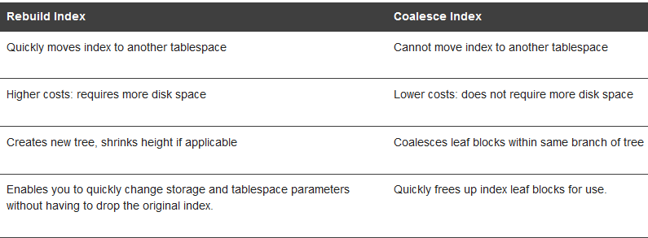
Index fragmentation
Improper sizing or increased growth can produce index fragmentation. To eliminate or reduce fragmentation, you can rebuild or coalesce the index.

Slide 83
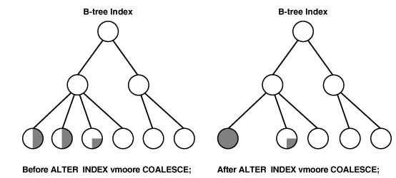
Coalescing Indexes
ALTER INDEX vmoore COALESCE;

Slide 84
CLUSTERS
A cluster provides an optional method of storing table data. A cluster is made up of a group of tables that share the same data blocks. The tables are grouped together because they share common columns and are often used together.
You should not use clusters for tables that are frequently accessed individually.
Because clusters store related rows of different tables together in the same data blocks, properly used clusters offer two primary benefits:
Since cluster stores related rows of different tables in same data blocks, Disk I/O is reduced and access time improves for joins of clustered tables.
Each cluster key value is stored only once each in the cluster and the cluster index, no matter how many rows of different tables contain the value.

Slide 85
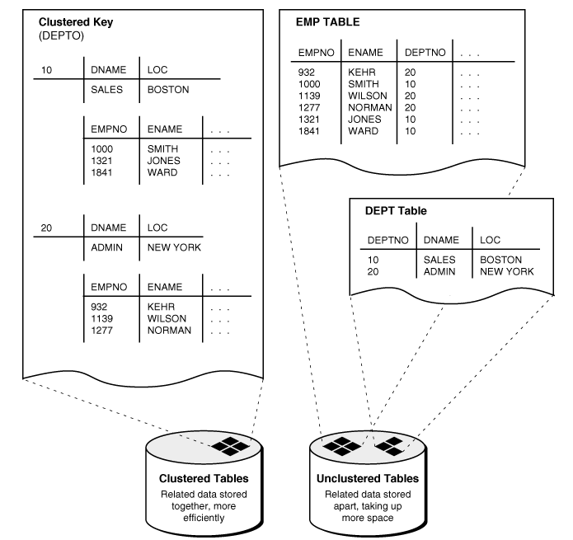
Cluster Looks like …

Slide 86
Guidelines for Managing Clusters
Choose Appropriate Tables for the Cluster
Choose Appropriate Columns for the Cluster Key
Same guideline as choosing index column
Specify the Space Required by an Average Cluster Key and Its Associated Rows ( Size Parameter )
Estimating the number of cluster keys (and associated rows) that can fit in a clustered data block
Limiting the number of cluster keys placed in a clustered data block. This maximizes the storage efficiency of keys within a cluster.
By default, the database stores only one cluster key and its associated rows in each data block of the cluster data segment
If all the rows for a given cluster key value cannot fit in one block, the blocks are chained together to speed access to all the values with the given key.
Specify the Location of Each Cluster and Cluster Index Rows
Estimate Cluster Size and Set Storage Parameters
The cluster and its cluster index can be created in different tablespaces. In fact, creating a cluster and its index in different tablespaces that are stored on different storage devices allows table data and index data to be retrieved simultaneously with minimal disk contention.

Slide 87
Materialized Views in Oracle
A materialized view in Oracle is a database object that contains the results of a query. They are local copies of data located remotely, or are used to create summary tables based on aggregations of a table's data.
Materialized views, which store data based on remote tables are also, know as snapshots.
A materialized view can query tables, views, and other materialized views. Collectively these are called master tables (a replication term) or detail tables (a data warehouse term).
For data warehousing purposes, the materialized views commonly created are aggregate views, single-table aggregate views, and join views.
For replication purposes, materialized views allow you to maintain copies of remote data on your local node. These copies are read-only. If you want to update the local copies, you have to use the Advanced Replication feature.
In replication environments, the materialized views commonly created are primary key, rowid, and subquery materialized views.

Slide 88
Materialized View Logs
Complete refreshes of materialized views can be expensive operations. Fortunately there is a way to refresh only the changed rows in a materialized view's base table. This is called fast refreshing. Before a materialized view can perform a fast refresh however it needs a mechanism to capture any changes made to its base table. This mechanism is called a Materialized View Log.

Slide 89
Basic Syntax of Materialized Views
CREATE MATERIALIZED VIEW view-name
BUILD [IMMEDIATE | DEFERRED]
[refresh [fast|complete|force]
[on demand | commit]
[start with date] [next date]
[with {primary key|rowid}]]
[[ENABLE | DISABLE] QUERY REWRITE]
[ON PREBUILT TABLE]
AS SELECT ...;

Slide 90
MV Syntax Key description
The BUILD clause options are shown below.
IMMEDIATE : The materialized view is populated immediately.
DEFERRED : The materialized view is populated on the first requested refresh.
The following refresh types are available.
FAST : A fast refresh is attempted. If materialized view logs are not present against the source tables in advance, the creation fails.
COMPLETE : The table segment supporting the materialized view is truncated and repopulated completely using the associated query.
FORCE : A fast refresh is attempted. If one is not possible a complete refresh is performed.
A refresh can be triggered in one of two ways.
ON COMMIT : The refresh is triggered by a committed data change in one of the dependent tables.
ON DEMAND : The refresh is initiated by a manual request or a scheduled task.
The QUERY REWRITE clause tells the optimizer if the materialized view should be consider for query rewrite operations. An example of the query rewrite functionality is shown below.
The ON PREBUILT TABLE clause tells the database to use an existing table segment, which must have the same name as the materialized view and support the same column structure as the query.

Slide 91
Regular Expressions
A regular expression is a notation for describing textual patterns. It consists of one or more literals and/or metacharacters that specify algorithms for performing complex text searches and modifications
Why Regular Expression?
These functions allow you to search for a pattern of characters in a string.
You can take advantage of a regular expression to determine valid formats for phone numbers, zip codes, Social Security numbers, IP addresses, file and path names, and so on.
Furthermore, you can locate patterns such as HTML tags, e-mail addresses, numbers, dates, or anything else that fits a pattern within any textual data and replace them with another pattern.
Understand Literals and metacharacters;
Example :, ‘DATA VEDA’ , ^196[5-8]$
There are five regular expression function as follows
REGEXP_LIKE (It is called operator as well instead of function)
REGEXP_INSTR
REGEXP_SUBSTR
REGEXP_REPLACE
REGEXP_COUNT ( Oracle 11g )

Slide 92
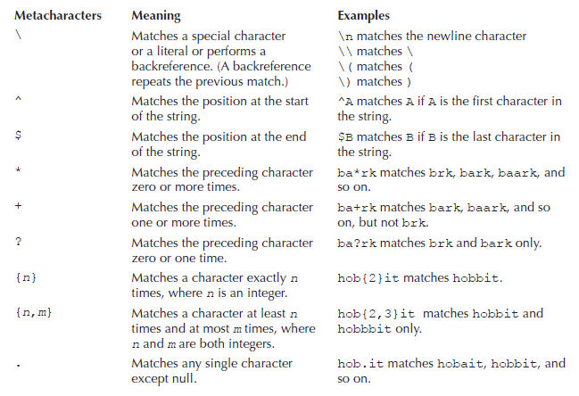
Regular Expression Metachracters

Slide 93


RE Metacharacter continue..

Slide 94

Perl Extensions in Regular Expression
Introduced in Oracle 11g

